Slide 1
CLIMATEWINS: ADVANCING WEATHER PREDICTION THROUGH MACHINE LEARNING Zahid Niloy An Interim Report Presentation Submitted to: Careerfoundry Date: 28 June, 2025

Slide 2
Introduction
Across Europe, climate change is reshaping the familiar. Weather patterns are growing more volatile, and communities face an increase in extreme events—storms, heatwaves, and cold snaps that challenge safety and predictability.
To protect lives and plan for the future, ClimateWins is turning to machine learning. Our mission is to:
- Detect weather anomalies outside typical regional patterns
- Track the rise of unusual weather events
- Forecast possible weather scenarios for the next 25 to 50 years
- Identify the safest European regions for long-term habitation

Slide 3
Three Thought Experiments
1. Classify Unusual Weather
Using hierarchical clustering, we can move beyond basic typical/atypical labels and uncover actionable groupings in regional weather behavior.
2. Generate Accurate Predictions
By applying a generative adversarial network (GAN) to synthesize new weather samples, and training a convolutional neural network (CNN) on that data, we can forecast climate trends over the next 50 years.
3. Identify Safe Living Regions
Through optimization of a random forest model, we can pinpoint the most important weather features linked to safety and assess which areas in Europe are best suited for future habitation.

Slide 4
We explored four core machine learning tools with unique strengths:
1. Hierarchical Clustering
Groups data without labels
Reveals hidden patterns
2. Random Forest
Shows which features matter most
Great for structured data
3. Convolutional Neural Networks(CNN)
Learns from images or weather patterns
Useful for visual analysis
4. Recurrent Neural Networks (RNN)
Learns from sequences over time
Ideal for weather forecasting

Slide 5

Additional Data Needs
To improve accuracy and prediction, ClimateWins should include:
- Records of extreme weather events
- Radar and satellite imagery
- Healthcare and emergency response data
- Defined hazardous weather classifications

Slide 6
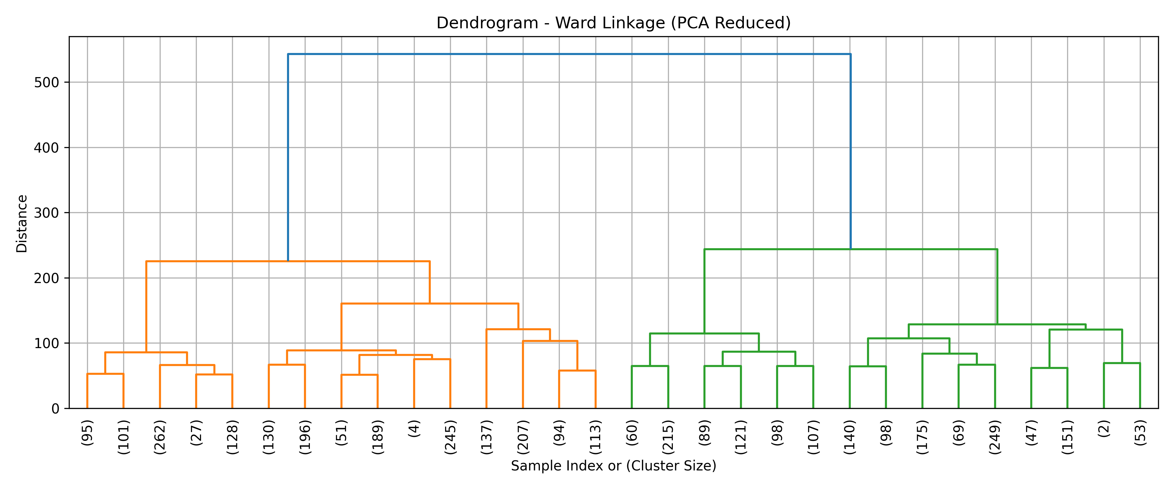
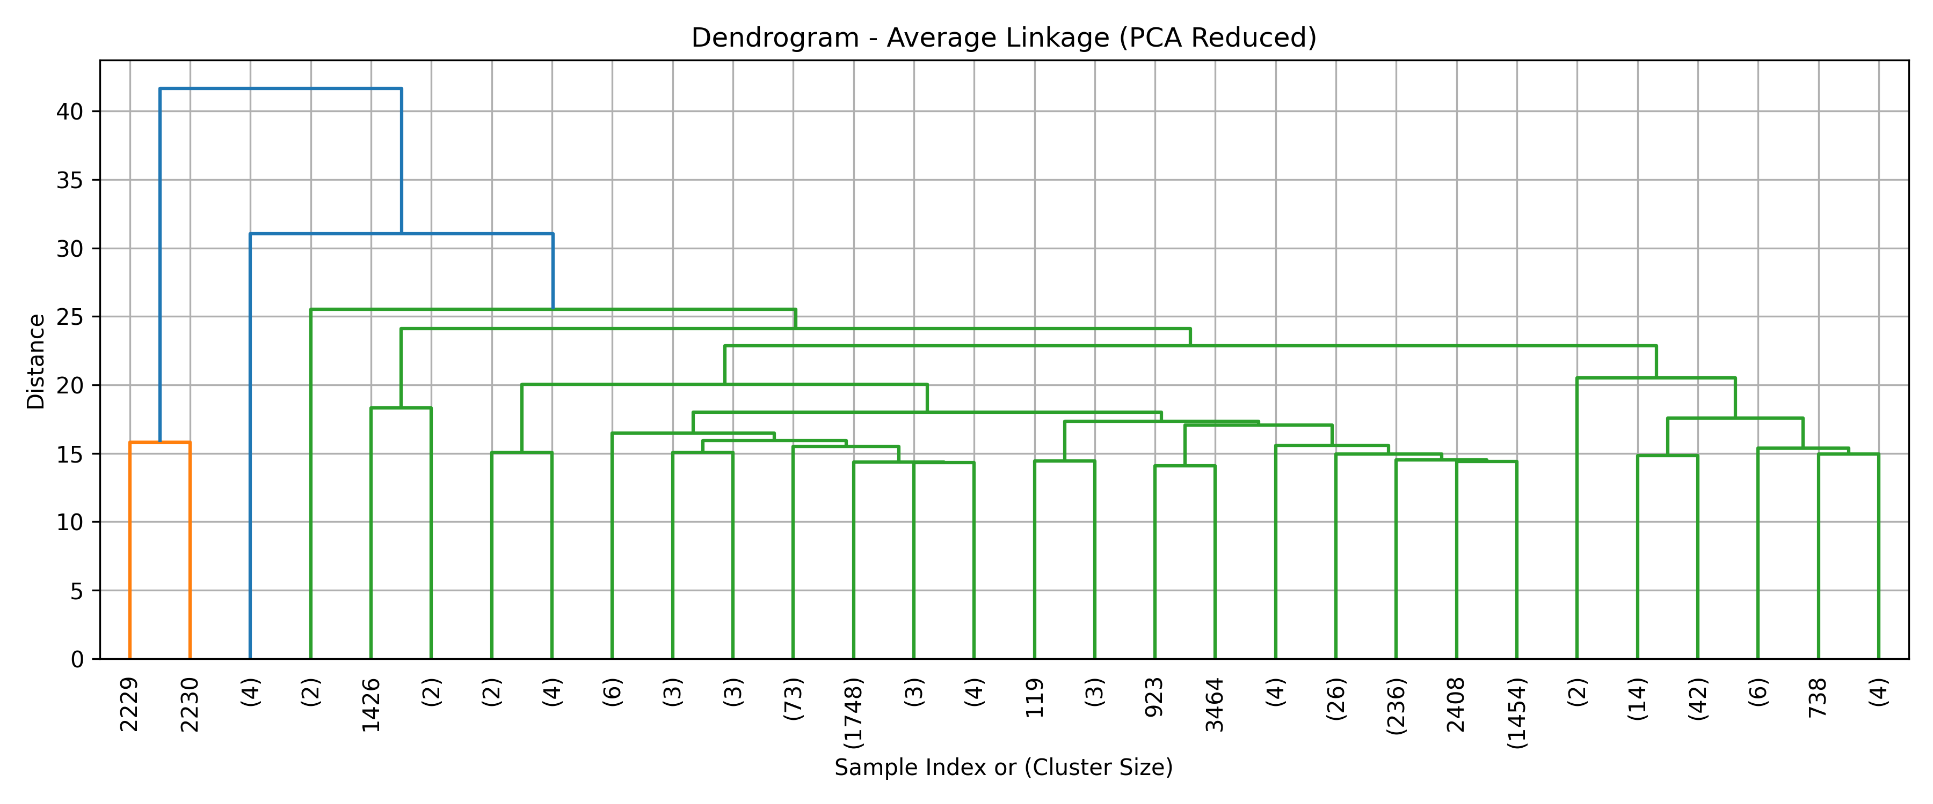
Classify Unusual Weather
Dendrograms
We simplified the data using Principal Component Analysis (PCA) while keeping most of the important details.
The model grouped the data into 21 clean weather types that are easy to interpret.
This method helps ClimateWins better organize and label unusual weather patterns in Europe for ongoing analysis.
🔷 Top Graphs – Accuracy & Loss Over Time These charts show the model getting smarter with each round — training accuracy improved to nearly 100%, and validation accuracy reached around 88%. Meanwhile, both training and validation losses dropped steadily, meaning the model made fewer mistakes as it learned.
🔷 Bottom Chart – Confusion Matrix The heatmap reveals that the model predicted Sunrise most accurately (22 correct), followed by Cloudy (18 correct). However, it sometimes confused Shine with Rain, showing that visually similar weather types are still challenging for the system to separate.

Slide 7
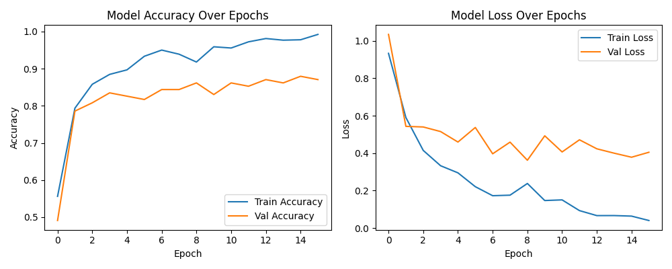
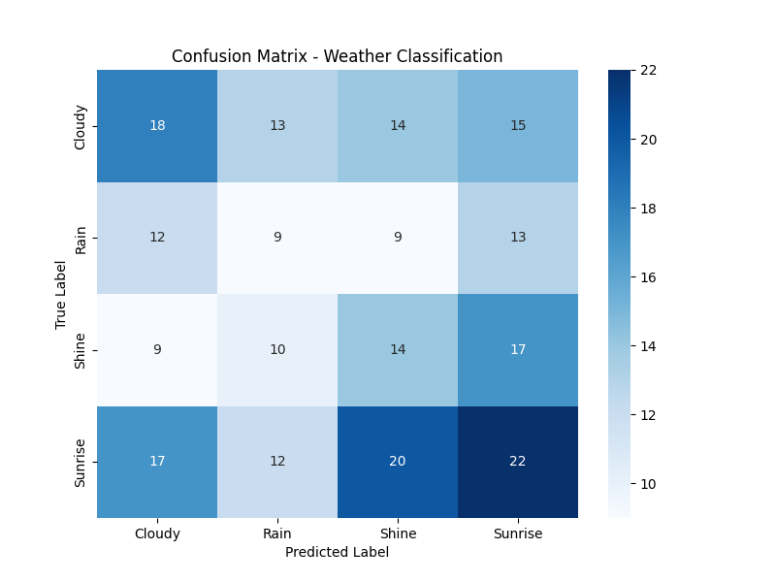
Generate Accurate Predictions
We created new weather data using Generative Adversarial Networks (GAN) to simulate realistic future conditions.
CNNs learned patterns from both original and generated data for better predictions.
The models achieved over 60% accuracy, showing that this method can help ClimateWins forecast long-term weather trends with more data and tuning.
🔷 Top Graphs – Accuracy & Loss Over Time The model's training accuracy climbed to nearly 100%, and validation accuracy held strong around 88%, showing it's learning well. At the same time, the error rate (loss) dropped sharply, proving that the model became more confident and consistent with more data.
🔷 Bottom Chart – Confusion Matrix The model did best predicting Sunrise (22 correct guesses) and Cloudy (18 correct), but often confused Rain and Shine, highlighting that similar weather types can still trip it up.

Slide 8
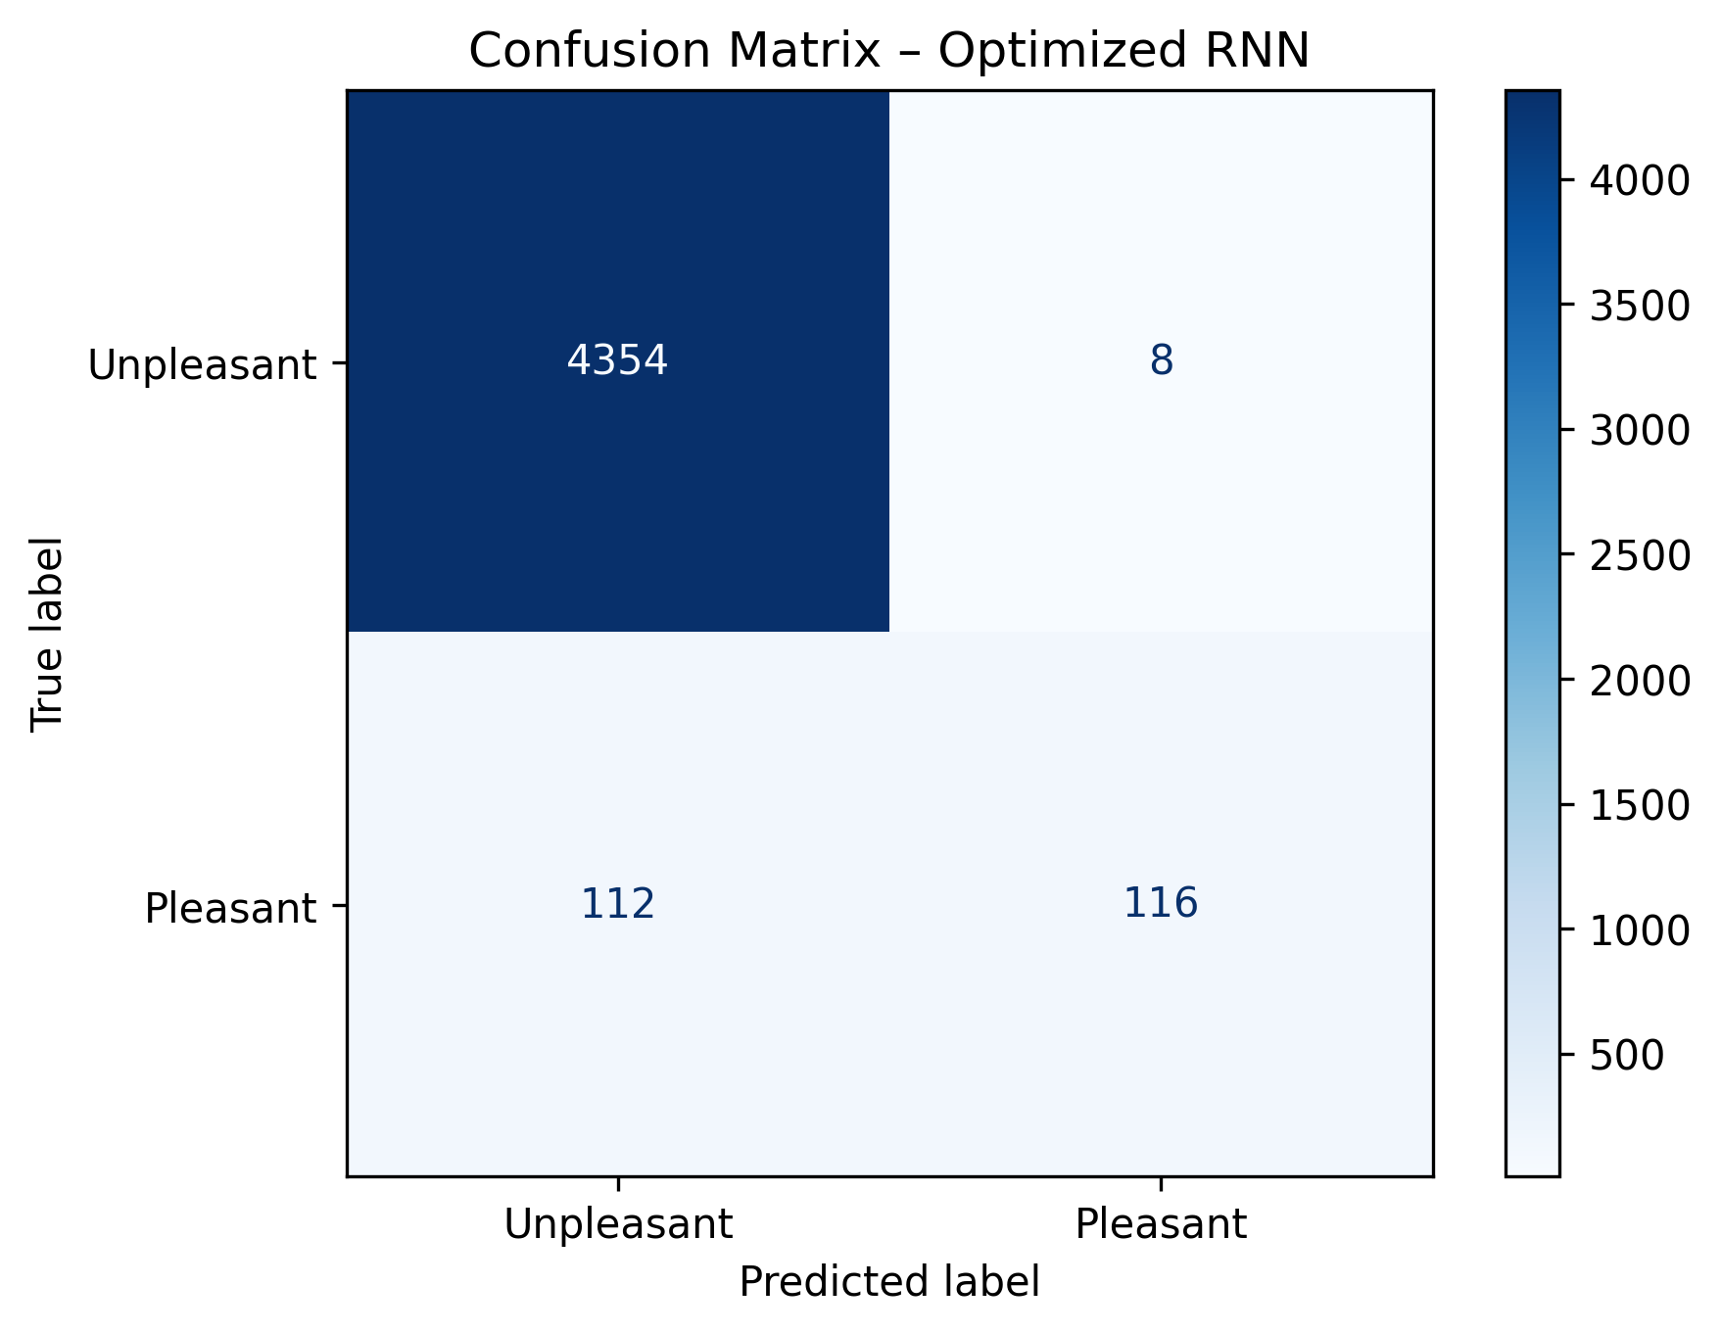
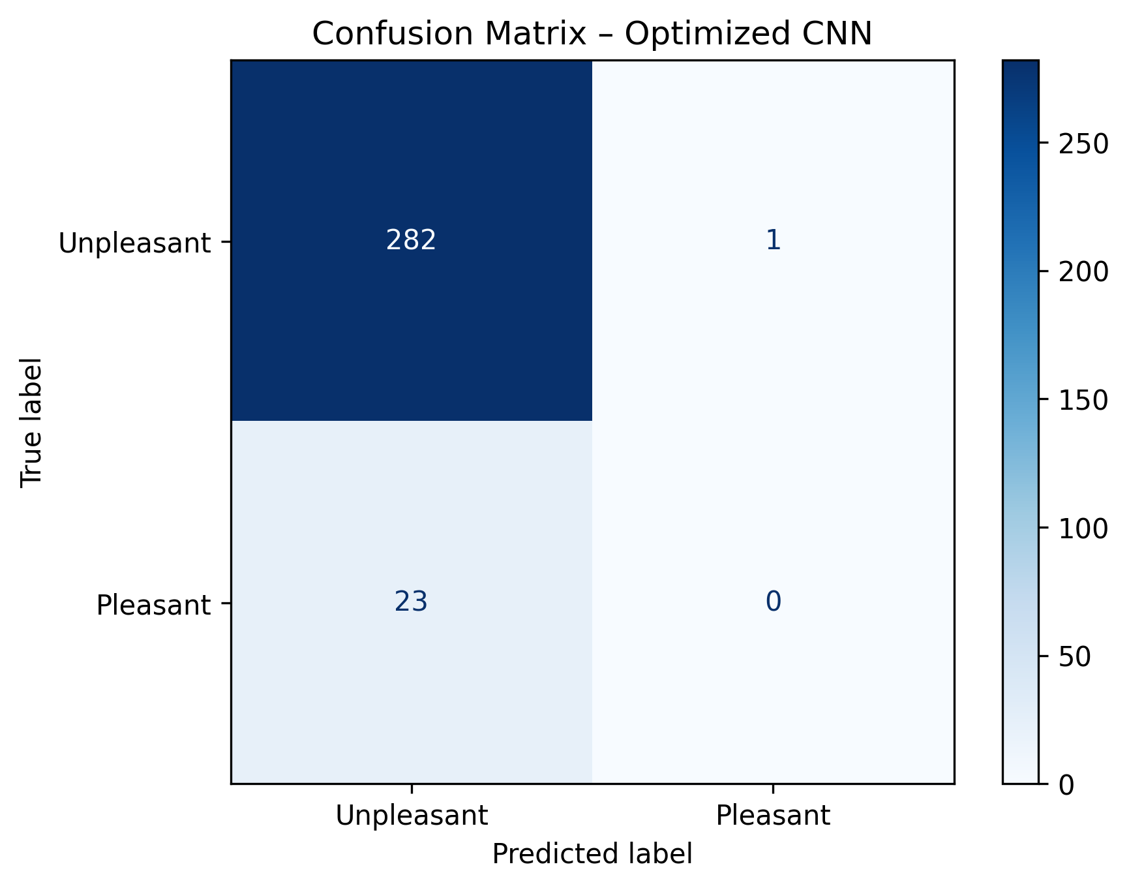
Identify Safe Living Regions 1
The Convolutional Neural Networks(CNN) model had difficulty recognizing pleasant days, especially in specific locations.
The Recurrent Neural Networks (RNN) achieved high accuracy by learning from time-based weather patterns, helping ClimateWins identify safer regions more reliably.
🔷 Top Right – Confusion Matrix (Optimized RNN) This matrix shows the RNN model was highly accurate in detecting “Unpleasant” days, correctly classifying 4,354 out of 4,362. It also identified 116 Pleasant days correctly — proving its strength in spotting safer weather patterns through time-based learning.
🔷 Bottom Right – Confusion Matrix (Optimized CNN) The CNN model struggled with Pleasant weather detection, identifying only 0 Pleasant days correctly out of 23, while accurately predicting 282 Unpleasant days. This suggests it may not be as reliable in identifying safe regions.

Slide 9
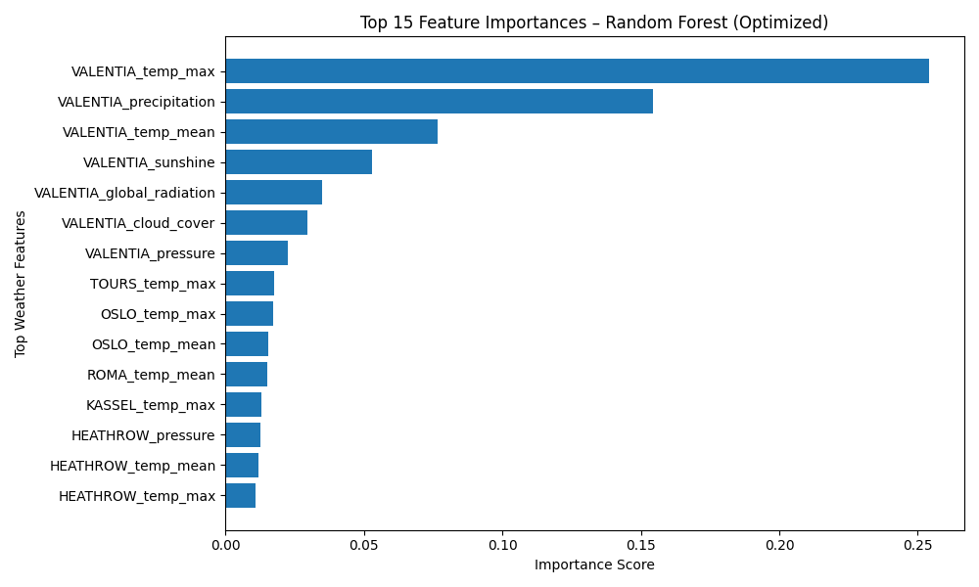
Identify Safe Living Regions 2
Random Forest showed that features like temperature and sunshine are the best predictors of safe weather.
Random Forest Feature Importance According to the Random Forest model, “VALENTIA_temp_max” and “VALENTIA_precipitation” were the top indicators of weather safety. Temperature, precipitation, and sunshine were the most decisive features for identifying safe living zones.

Slide 10

Summary of Recommendations
We recommend using Recurrent Neural Networks (RNN) for time-based learning and Random Forests for feature clarity.
These two, along with Convolutional Neural Networks(CNN) and Generative Adversarial Networks (GAN), offer the strongest tools for weather prediction.
ClimateWins should now collect more data, rebalance the dataset, and test combinations of these models for the best results.
These steps offer a simple roadmap: build smarter models, use clearer data, and test how different tools can work together to improve forecasting accuracy.

Slide 11

Visual Weather Applications
The digit recognition model proved that Convolutional Neural Networks (CNNs) can learn from patterns quickly and effectively.
A second CNN learned to classify weather types from photos—like identifying clouds or rain.
We proposed using Generative Adversarial Networks (GAN) to create future satellite views, improve blurry radar images, and fill in missing data with realistic examples.
These applications demonstrate how visual machine learning tools can be used not only for analysis but for improving emergency response and climate communication.

Slide 12
Thank you
Let’s get in touch:
Gmail : zahidniloy50@gmail.com
LinkedIn: https://www.linkedin.com/in/zahid-niloy
GitHub: https://github.com/zahidniloy
Link to Github notebook for this project:
https://github.com/zahidniloy/ML-Based-Weather-Prediction-/tree/main
Portfolio site: https://zahidniloy50.wixsite.com/zahid-niloy

